Slide 1
CIS 315 Introduction to Systems Analysis Requirements Analysis
Stefan Bund, MS
Cal Poly Pomona CBA/CIS
Lecture 4

Slide 2
Defining a Requirement

Slide 3
Requirements

Slide 4
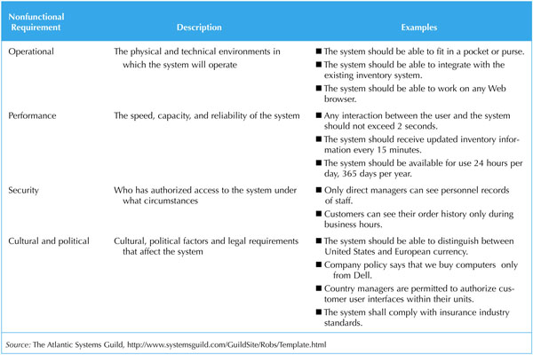
Nonfunctional Requirements

Slide 5
Laws or Regulations Affecting IS
Sarbanes–Oxley Act
aka the 'Public Company Accounting Reform and Investor Protection Act‘
The bill was enacted as a reaction to a number of major corporate and accounting scandals including those affecting Enron, Tyco International, and WorldCom.
The act contains 11 titles ranging from additional corporate board responsibilities to criminal penalties, and requires the Securities and Exchange Commission (SEC) to implement rulings on requirements to comply with the law.
COBIT compliance
COBIT, initially an acronym for 'Control OBjectives for Information and related Technology' defines 34 generic processes to manage IT.
It is a supporting toolset that allows managers to bridge the gap between control requirements, technical issues and business risks.
Notes:
Employee intellectual property agreement, class communication using csupomona.edu email

Slide 6
Laws or Regulations Affecting IS
ISO 9000 compliance
is a family of standards related to quality management systems and designed to help organizations ensure that they meet the needs of customers and other stakeholders.
ISO 9000 deals with the fundamentals of quality management systems.
Capability Maturity Model compliance
The Capability Maturity Model (CMM) was originally developed as a tool for objectively assessing the ability of government contractors' processes to perform a contracted software project.
"maturity" relates to the degree of formality and optimization of processes, from ad hoc practices, to formally defined steps, to managed result metrics, to active optimization of the processes.
What may happen if you ignore non-functional requirements?
Textbook P114

Slide 7
Requirements Analysis Strategies

Slide 8
Business Process Automation
BPA leaves the basic way in which the organization operates unchanged and uses computer technology to do some of the work
Low risk, but low payoff
Planners in BPA projects invest significant time in understanding the as-is system (using the following two common BPA techniques:)
Problem analysis
Root cause analysis

Slide 9
Problem Analysis

Slide 10
Root Cause Analysis
For example, what do you do when light bulb in your room burns out frequently?
How can you use root cause analysis on this problem? How many possible root causes are there? And their solutions?

Slide 11
Business Process Improvement
BPI makes moderate changes to the way in which the organization operates to take advantage of new opportunities offered by technology or to copy what competitors are doing.

Slide 12
Business Process Improvement

Slide 13
Business Process Reengineering

Slide 14
Business Process Reengineering

Slide 15
Selecting the Appropriate Strategies
 | Business Process Automation | Business Process Improvement | Business Process Reengineering
Potential benefit | Low–moderate | Moderate | High
Project cost | Low | Low–moderate | High
Breadth of analysis | Narrow | Narrow-moderate | Very broad
Risk | Low–moderate | Low–moderate | Very high

Slide 16
Requirements-Gathering Techniques

Slide 17
Requirements Gathering Techniques

Slide 18
Five Basic Steps of Interviews

Slide 19
Selecting Interviewees

Slide 20
Interviewing Strategies
Top-down
How
can order
processing be
improved?
High-level:
Very general
Medium-level:
Moderately specific
How can we reduce the
number of times that customers
return ordered items?
Low-level:
Very specific
How can we reduce the number of
errors in order processing (e.g., shipping
the wrong products)?
Bottom-up
Notes:
Use bottom up when u know the problem domain well and know exact questions to ask.

Slide 21
Joint Application Development

Slide 22
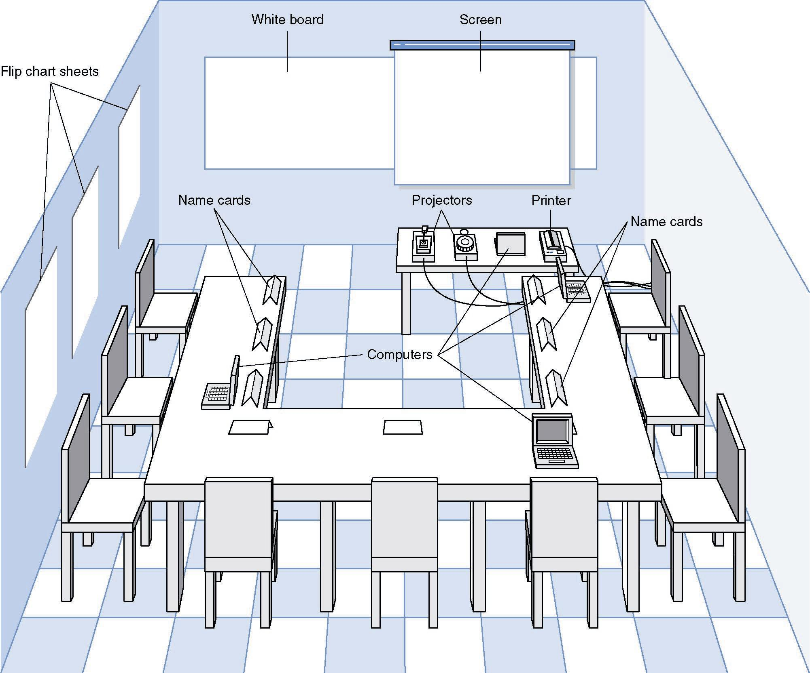
JAD Meeting Room
JPEG Figure 5-5 Goes Here
Notes:
Like a jury room

